Slide 1
4-d. Vacuum Sealed Molding Process
It is a process of making molds utilizing dry sand, plastic film and a physical means of binding using negative pressure or vacuum. V-process was developed in Japan in 1971. Since then it has gained considerable importance due to its capability to produce dimensionally accurate and smooth castings. The basic difference between the V-process and other sand molding processes is the manner in which sand is bounded to form the mold cavity. In V-process vacuum, of the order of 250 – 450 mm Hg, is imposed to bind the dry free flowing sand encapsulated in between two plastic films. The technique involves the formation of a mold cavity by vacuum forming of a plastic film over the pattern, backed by unbounded sand, which is compacted by vibration and held rigidly in place by applying vacuum. When the metal is poured into the molds, the plastic film first melts and then gets sucked just inside the sand voids due to imposed vacuum where it condenses and forms a shell-like layer. The vacuum must be maintained until the metal solidifies, after which the vacuum is released allowing the sand to drop away leaving a casting with a smooth surface. No shakeout equipment is required and the same sand can be cooled and reused without further treatment. The steps of the process are explained in Figure 10.1

Slide 2
Sequence of Producing V-Process Molds
The Pattern is set on the Pattern Plate of Pattern Box. The Pattern as well as the Pattern Plate has Numerous Small Holes. These Holes Help the Plastic Film to Adhere Closely on Pattern When Vacuum is Applied.
A Heater is used to Soften the Plastic Film

Slide 3
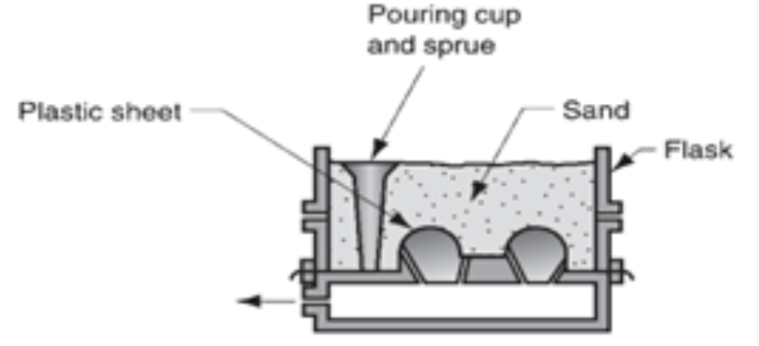
The Softened Plastic Film Drapes over the Pattern. The Vacuum Suction Acts through the Vents (Pattern and Pattern Plate) to draw it so that it adheres closely to the Pattern.
. The Molding Box is Set on the Film Coated Pattern
The Molding Box is filled with Dry Sand. Slight Vibration Compacts the Sand

Slide 4
Level the Mold. Cover the Top of Molding Box with Plastic Film. Vacuum Suction Stiffens the Mold.
Release the Vacuum on the Pattern Box and Mold Strips Easily.
Cope and Drag are assembled and Metal is poured. During Pouring the Mold is Kept under Vacuum
After Cooling, the Vacuum is released. Free Flowing Sand Drops Away, Leaving a Clean Casting

Slide 5
Advantages
Exceptionally Good Dimensional Accuracy
Good Surface Finish
Longer Pattern Life
Consistent Reproducibility
Low Cleaning / Finishing Cost

Slide 6
4-e. Centrifugal Casting
In this process, the mold is rotated rapidly about its central axis as the metal is poured into it. Because of the centrifugal force, a continuous pressure will be acting on the metal as it solidifies. The slag, oxides and other inclusions being lighter get separated from the metal and segregate towards the center. This process is normally used for the making of hollow pipes, tubes, hollow bushes, etc., which are ax symmetric with a concentric hole. Since the metal is always pushed outward because of the centrifugal force, no core needs to be used for making the concentric hole. The mold can be rotated about a vertical, horizontal or an inclined axis or about its horizontal and vertical axes simultaneously. The length and outside diameter are fixed by the mold cavity dimensions while the inside diameter is determined by the amount of molten metal poured into the mold.

Slide 7
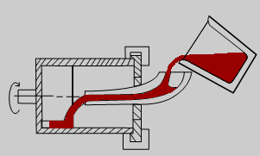
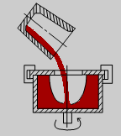
(Horizontal and Vertical Centrifugal Casting)

Slide 8
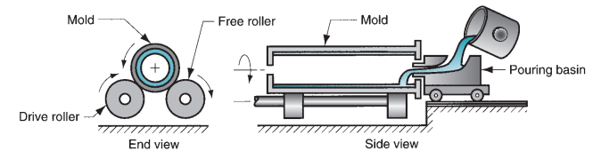
Setup for true centrifugal casting.

Slide 9
True Centrifugal Casting In true centrifugal casting, molten metal is poured into a rotating mold to produce a tubular part. Examples of parts made by this process include pipes, tubes, bushings, and rings. One possible setup is illustrated in Figure 10.3. Molten metal is poured into a horizontal rotating mold at one end. In some operations, mold rotation commences after pouring has occurred rather than beforehand. The high-speed rotation results in centrifugal forces that cause the metal to take the shape of the mold cavity. Thus, the outside shape of the casting can be rounding, octagonal, hexagonal, and so on. However, the inside shape of the casting is (theoretically) perfectly round, due to the radially symmetric forces at work

Slide 10
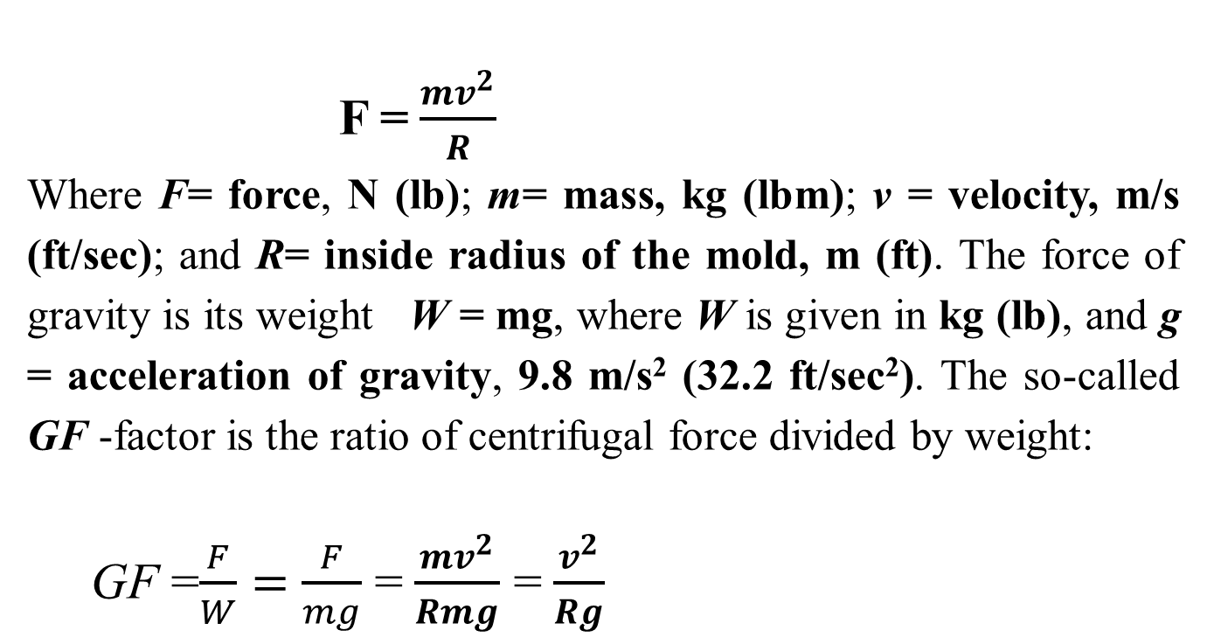
Orientation of the axis of mold rotation can be either horizontal or vertical, the former being more common. Let us consider how fast the mold must rotate in horizontal centrifugal casting for the process to work successfully. Centrifugal force is defined by this physics equation:
F =$\frac{{mv}^{2}}{R}$
Where F= force, N (lb); m= mass, kg (lbm); ν = velocity, m/s (ft/sec); and R= inside radius of the mold, m (ft). The force of gravity is its weight W = mg, where W is given in kg (lb), and g = acceleration of gravity, 9.8 m/s² (32.2 ft/sec²). The so-called GF -factor is the ratio of centrifugal force divided by weight:
GF =$\frac{F}{W}=$ $\frac{F}{mg}$ =$\frac{{mv}^{2}}{Rmg}$ =$\frac{v^{2}}{Rg}$

Slide 11
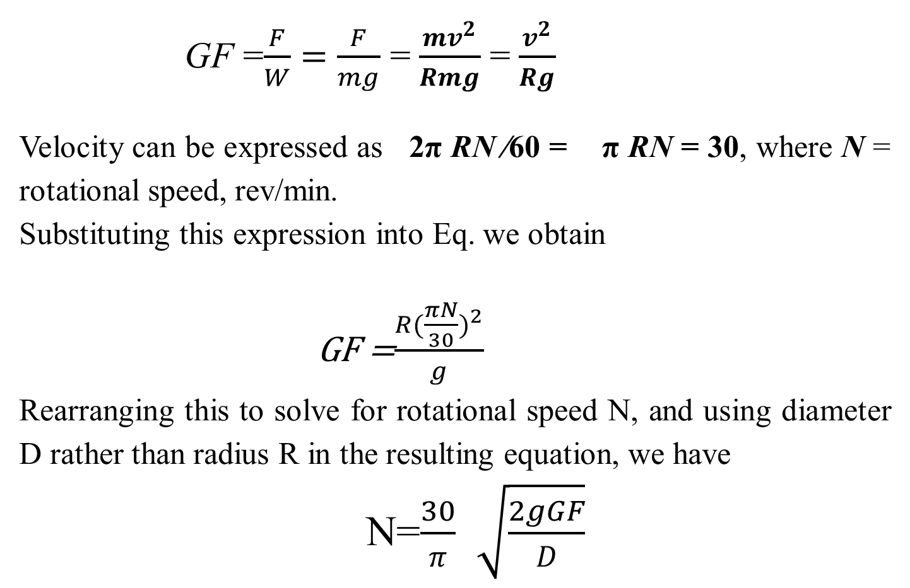
GF =$\frac{F}{W}=$ $\frac{F}{mg}$ =$\frac{{mv}^{2}}{Rmg}$ =$\frac{v^{2}}{Rg}$
Velocity can be expressed as 2π RN ∕60 = π RN = 30, where N = rotational speed, rev/min.
Substituting this expression into Eq. we obtain
GF =$\frac{R({\frac{πN}{30})}^{2}}{g}$
Rearranging this to solve for rotational speed N, and using diameter D rather than radius R in the resulting equation, we have
N=$\frac{30}{π}$ $\sqrt{\frac{2gGF}{D}}$

Slide 12
Where D inside diameter of the mold, m (ft) . If the G-factor is too low in centrifugal casting, the liquid metal will not remain forced against the mold wall during the upper half of the circular path but will ‘‘rain’’ inside the cavity. Slipping occurs between the molten metal and the mold wall, which means that the rotational speed of the metal is less than that of the mold. On an empirical basis, values of GF=60 to 80 are found to be appropriate for horizontal centrifugal casting, although this depends to some extent on the metal being cast.

Slide 13
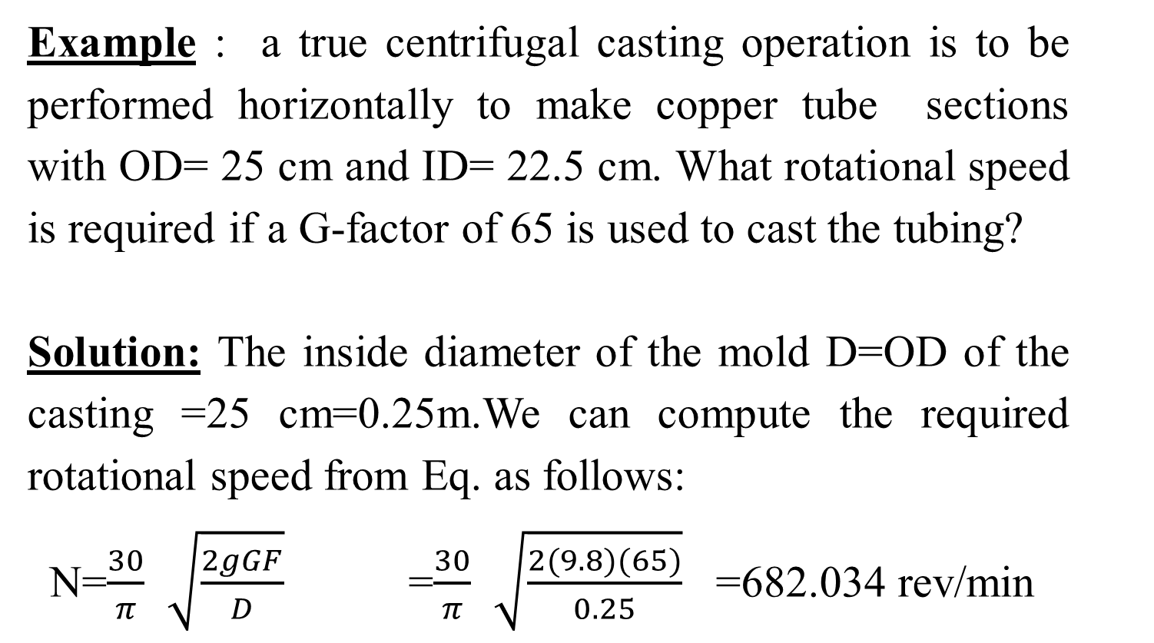
Example : a true centrifugal casting operation is to be performed horizontally to make copper tube sections with OD= 25 cm and ID= 22.5 cm. What rotational speed is required if a G-factor of 65 is used to cast the tubing?
Solution: The inside diameter of the mold D=OD of the casting =25 cm=0.25m.We can compute the required rotational speed from Eq. as follows:
N=$\frac{30}{π}$ $\sqrt{\frac{2gGF}{D}}$ =$\frac{30}{π}$ $\sqrt{\frac{2(9.8)(65)}{0.25}}$ =682.034 rev/min

Slide 14
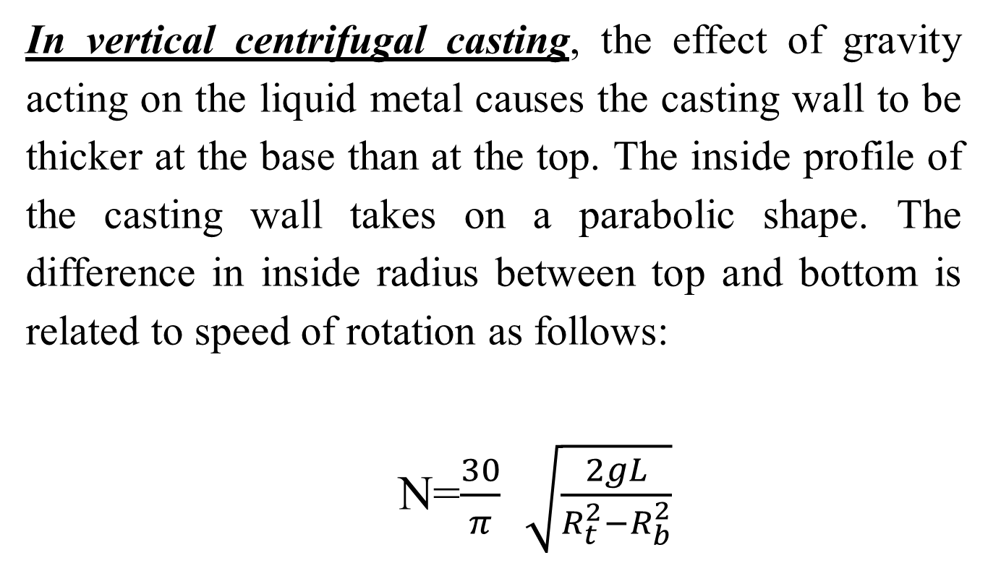
In vertical centrifugal casting, the effect of gravity acting on the liquid metal causes the casting wall to be thicker at the base than at the top. The inside profile of the casting wall takes on a parabolic shape. The difference in inside radius between top and bottom is related to speed of rotation as follows:
N=$\frac{30}{π}$ $\sqrt{\frac{2gL}{R_{t}^{2}−R_{b}^{2}}}$

Slide 15
where L= vertical length of the casting, m (ft); R_{t} = inside radius at the top of the casting, m (ft); and R_{b}= inside radius at the bottom of the casting, m (ft).This Equation can be used to determine the required rotational speed for vertical centrifugal casting, given specifications on the inside radii at top and bottom. One can see from the formula that for R_{t} to equal R_{b} , the speed of rotation N would have to be infinite, which is impossible of course. As a practical matter, part lengths made by vertical centrifugal casting are usually no more than about twice their diameters. This is quite satisfactory for bushings and other parts that have large diameters relatively to their lengths, especially if machining will be used to accurately size the inside diameter.

Slide 16
Castings made by true centrifugal casting are characterized by high density, especially in the outer regions of the part where F is greatest. Solidification shrinkage at the exterior of the cast tube is not a factor, because the centrifugal force continually reallocates molten metal toward the mold wall during freezing. Any impurities in the casting tend to be on the inner wall and can be removed by machining if necessary

Slide 17
Advantages
- - Formation of hollow interiors in cylinders without cores
- - Less material required for gate
- - Fine grained structure at the outer surface of the casting - - free of gas and shrinkage cavities and porosity
Disadvantages
More segregation of alloy component during pouring under the forces of rotation
Contamination of internal surface of castings with non-metallic inclusions
Inaccurate internal diameter

